Slide 1

C++ Project Review-1
COMPLAINT MANAGEMENT SYSTEM
BATCH NO : 18
Presented By:
25B11AI218 – CH V KOUSHIK
25B11AI821– N ROHITH VARMA
25B11AI905 – P SURYA VAMSI
26B21AI046 – J SHANKAR
Under esteemed guidance of:
Ms. N AKHILA
M.Tech(Ph.D), Assistant Professor (AIML)

Slide 2
PROJECT ABSTRACT
C++ based complaint management system.
Used to register and manage complaints.
Complaints are stored in a text file.
Users can view and search complaints.
Complaints can be resolved and updated

Slide 3
PROBLEM STATEMENT
Difficult to track complaint status.
Records may be lost or misplaced.
Updating complaints manually is difficult.
Manual complaint management is time-consuming.

Slide 4
OBJECTIVES
Store complaint details.
Search complaints using Complaint ID.
View all complaints.
Resolve complaints and update status.
Reduce manual work.
Register complaints easily.

Slide 5
USERS OF THE SYSTEM
User/Student
Register complaint
View complaints
Search complaint
Check complaint status
2. Complaint Handler/Admin
View complaints
Search complaints
Resolve complaints
Maintain complaint records

Slide 6
PLANNED MODULES / FUNCTIONS
1. Register Complaint
Enter Complaint ID
Enter Name
Enter Phone Number
Enter Complaint Description
Status is initially set to Pending
2. View Complaints
Displays all complaints stored in the system.
3.Search Complaint
Searches a complaint using its Complaint ID.
4. Resolve Complaint
Changes the complaint status from Pending to Resolved.
Displays:
  Complaint ID
  Name
  Status
5. Delete Complaint
Removes a complaint record when required.
6.File Handling
Stores complaint information in complaints.txt.

Slide 7
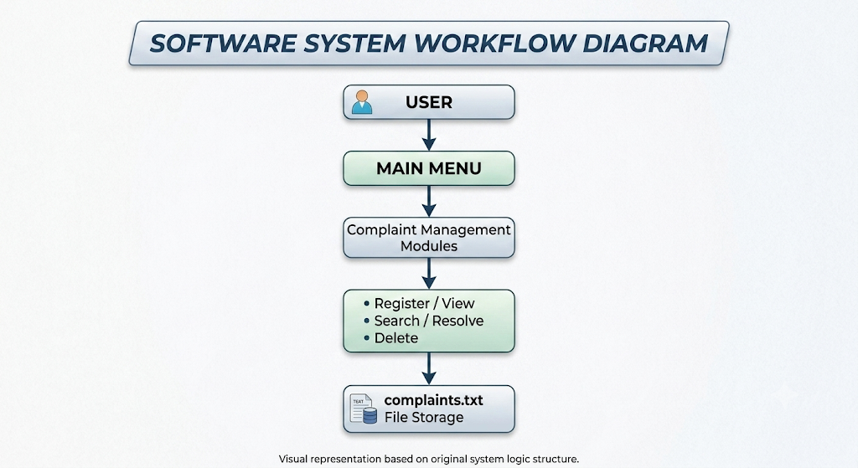
ARCHITECTURE DIAGRAM

Slide 8
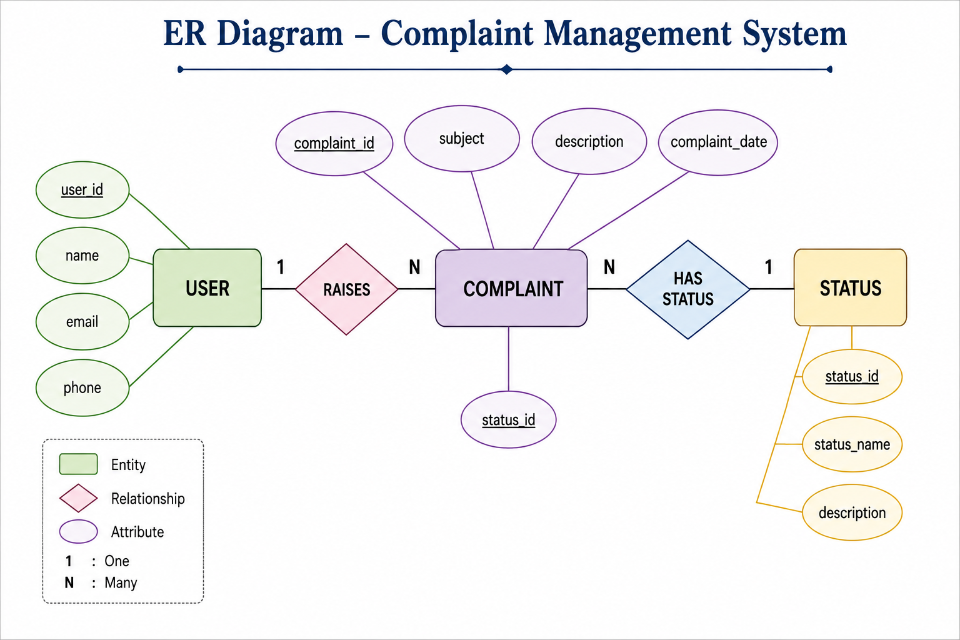
ER DIAGRAM / DFD

Slide 9
C++ CONCEPTS USED
Class & Objects
Encapsulation
Constructor
Member Functions
Array of Objects
Functions
Conditional Statements
Switch Case
Loops
Strings

Slide 10
LIMITATIONS AND FUTURE ENHANCEMENT
Limitations | Future Enhancements
No permanent data storage | Database integration
No user authentication | Secure user and Principal login
Limited number of complaints | Unlimited complaint storage
Basic status management | Advanced complaint tracking
No notifications | Email/SMS notifications
No online access | Web/Mobile application
Basic reporting | Dashboard with detailed reports

Slide 11
PLANNING AND TIMELINE DIAGRAM
W1
W2
W3
W4
W5
W6
W7
Requirement Analysis
System Design (Class/ER Diagrams)
Coding & Module Development
Integration & Testing
Documentation & Final Review

Slide 12
ROLE OF EACH INDIVIDUAL
Roll No. | Name | Role / Responsibility
25B11AI218 | CH.V. KOUSHIK | Class design, Event & Registration modules
25B11AI018 | P.SURYA VAMSI | Coding – core modules & file handling
25B11AI821 | N.ROHITH VARMA | Testing, debugging & report generation
26B21AI046 | J.SHANKAR | UI design, documentation & presentation

Slide 13
THANK YOU

